Slide 1


User Experience Design/Testing Lab 3 Instructor: Prof. Vishal Chawla
College of Engineering

Slide 2
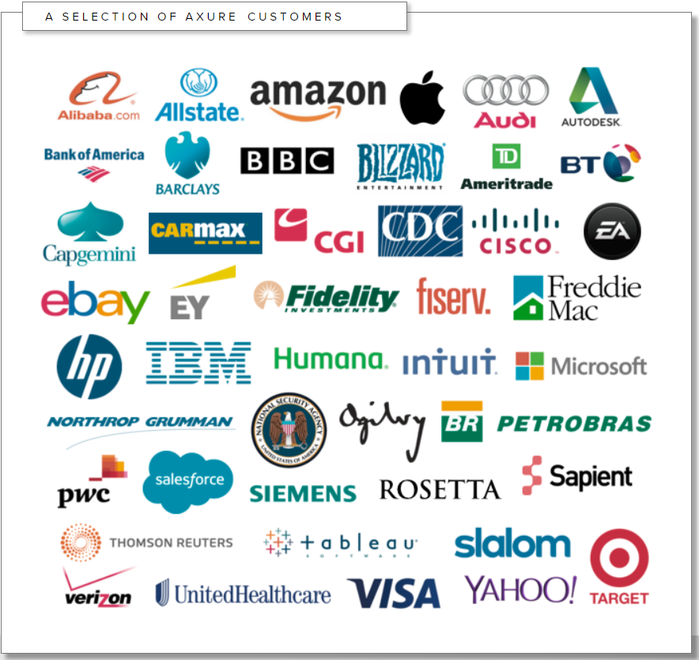
Axure RP “Industry Leader for 16 years”
College of Engineering
What is Axure?
A tool used for –
Planning
Wireframing
Prototyping
Documenting
What can it be used for?
Desktop Applications
Browser based applications
Mobile Applications

Slide 3
A bit more about Axure RP
Launched in 2002 and one of the first dedicated prototyping package
Free 30-day trail available, 1-year free license of students
Fast becoming the ‘industry standard’ tool for UX designers
What makes it Different?
We can create something realistic

Slide 4
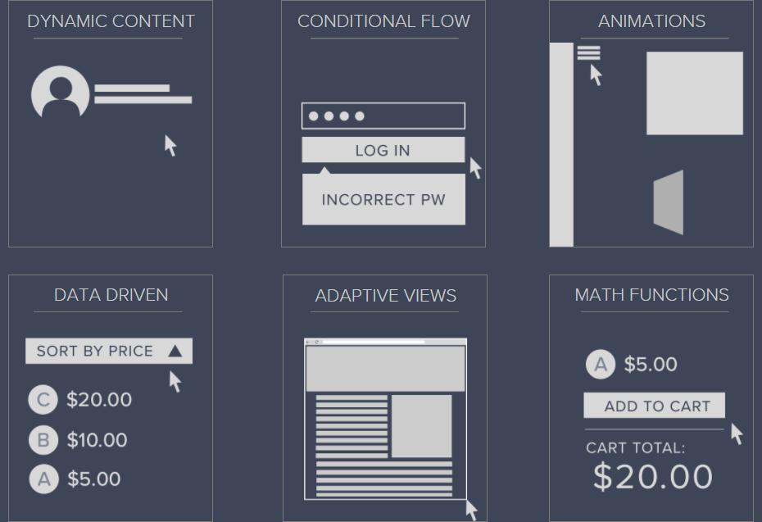
Key features:
Dynamic Panels
Conditional flow
Animations
Data Driven
Math functions
Basic interactions
Flow Diagrams

Slide 5
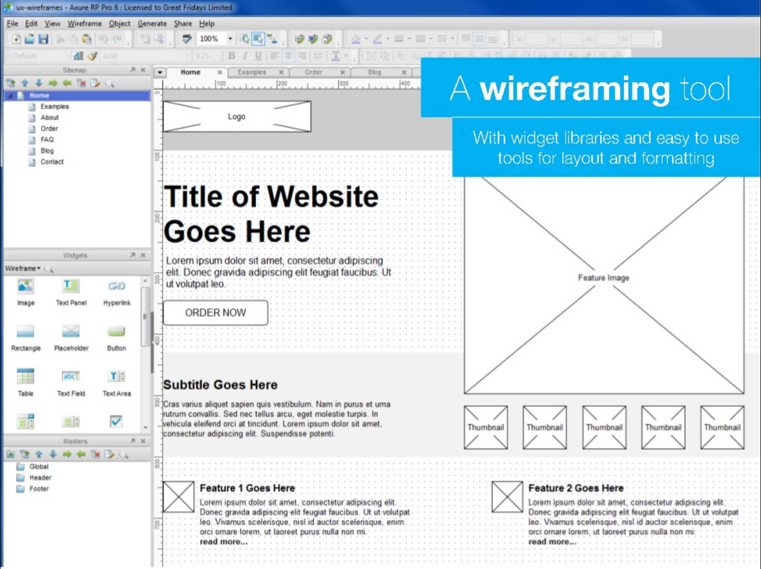
Wireframing tool
College of Engineering

Slide 6
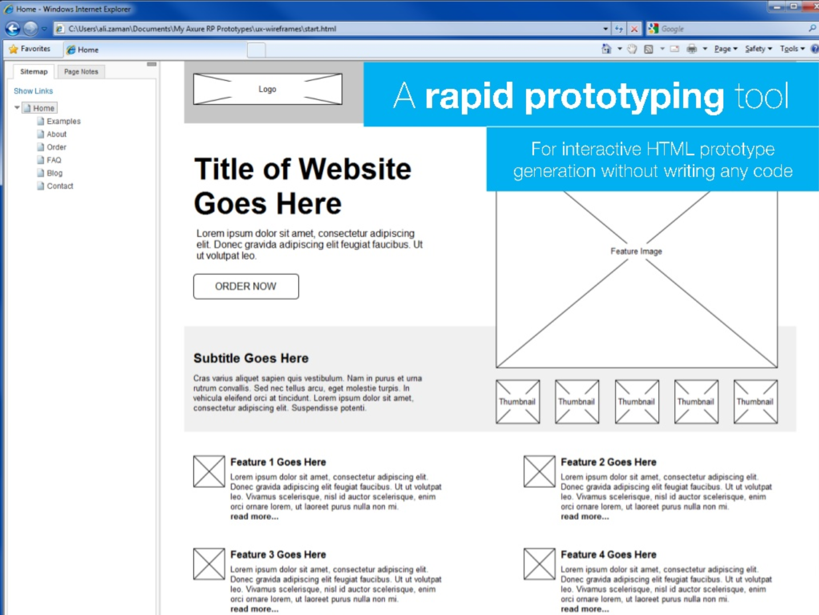
Rapid prototyping tool
College of Engineering

Slide 7
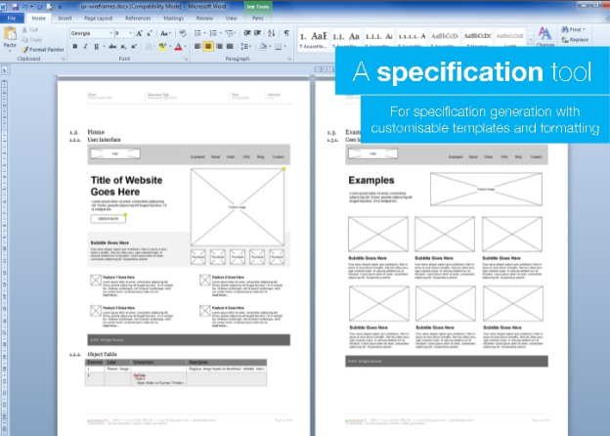
Specification tool

Slide 8

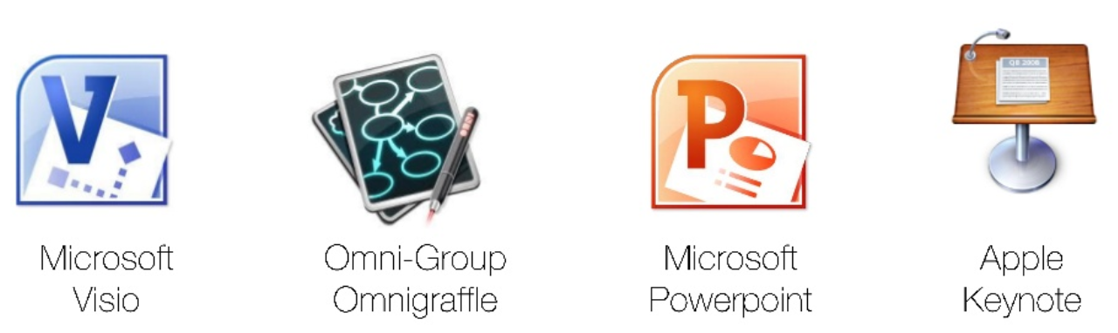

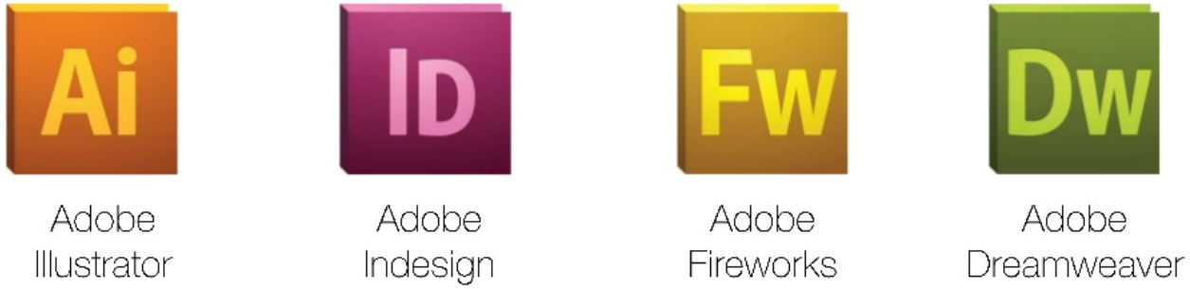
Some Axure alternatives
College of Engineering

Slide 9

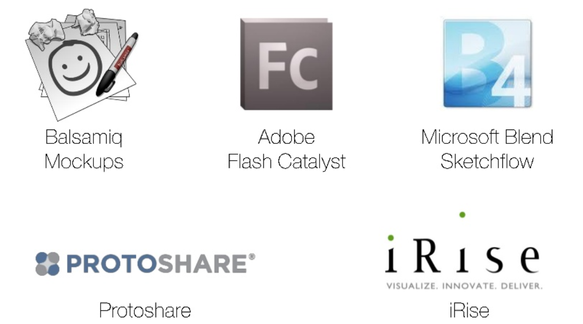
Some Axure alternatives
College of Engineering

Slide 10
Why use Axure RP?
Diagramming + Documentation
Easier team collaboration
Awesome official docs and support community
Cross Platform
Easy to share
Quick and easy to test out ideas

Slide 11
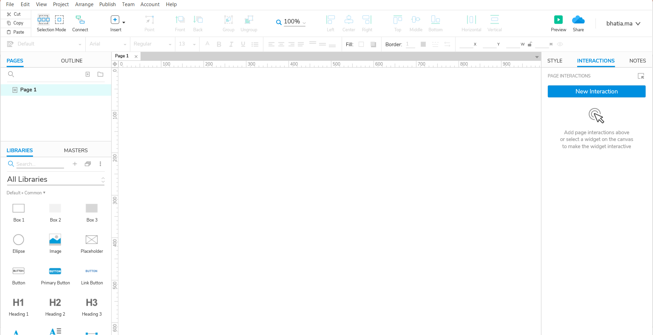
Axure RP screenshot
College of Engineering

Slide 12

College of Engineering

